Slide 1
Amazon Recommendation System
By: John C

Slide 2
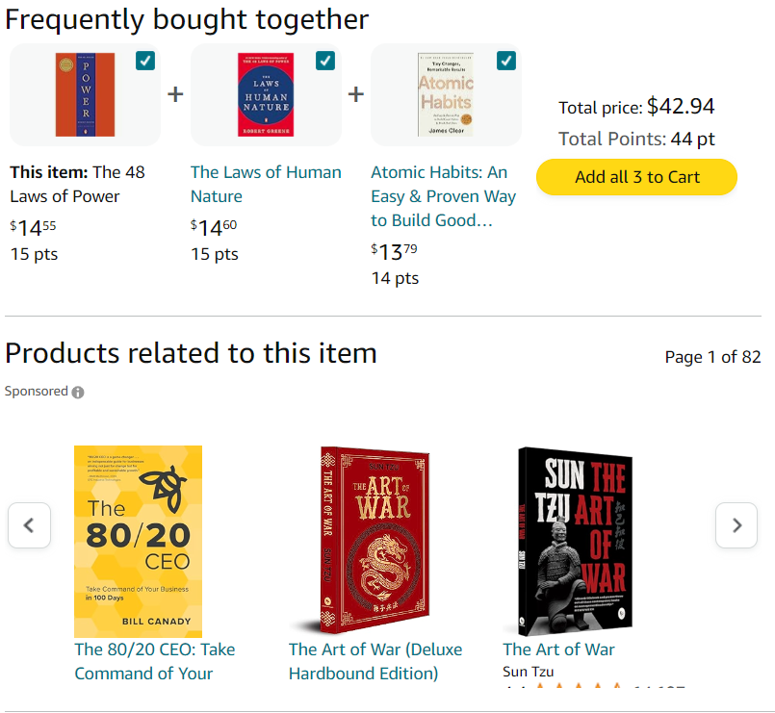
What is a Recommendation System
They designed to predict and display items that user is likely to purchase or interact with (Personalizing the shopping experience)

Slide 3
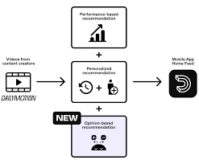
How it works
In our approach, we use products that have similar categories with similar product description, and user behavior to predict product
We create a text that represent this as a whole and use cosine similarity to recommend the products based on that
This is called a profile vector

Slide 4
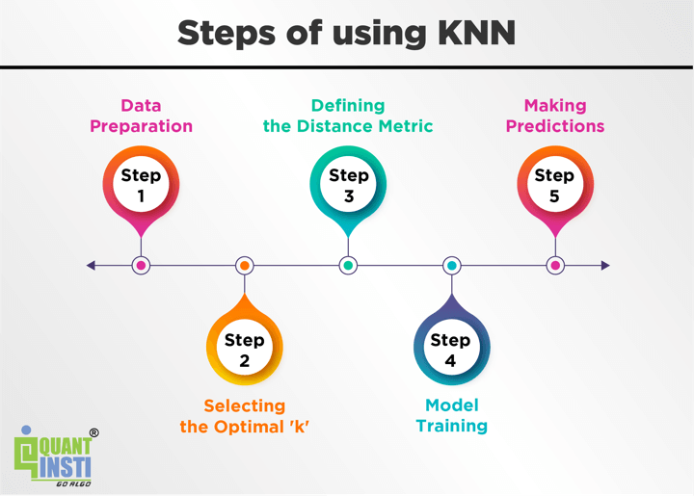
Outline of Implementation
Data Preprocessing
EDA
Feature Engineering
Modeling

Slide 5
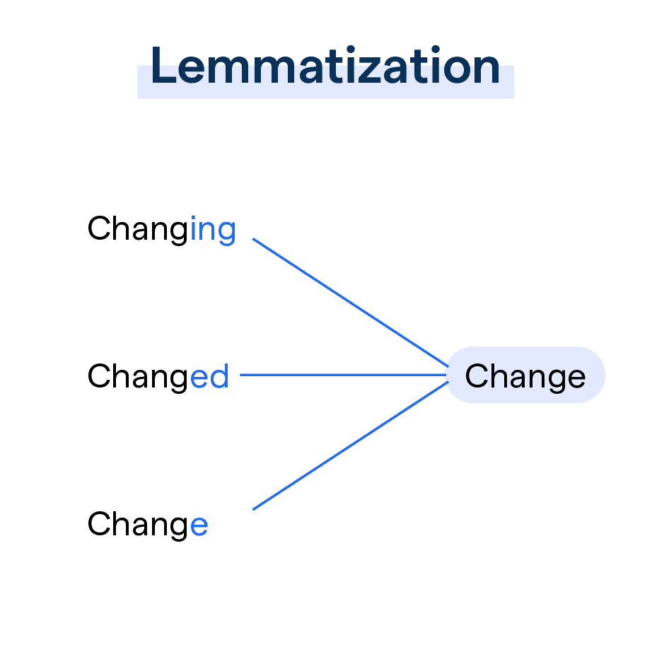
Data Processing
Key features such as discounted-price and actual_price were initially formatted as ‘object types’
Product names and categories were normalized by converting to lowercase, removing punctuations, and performing lemmatization for future feature engineering

Slide 6
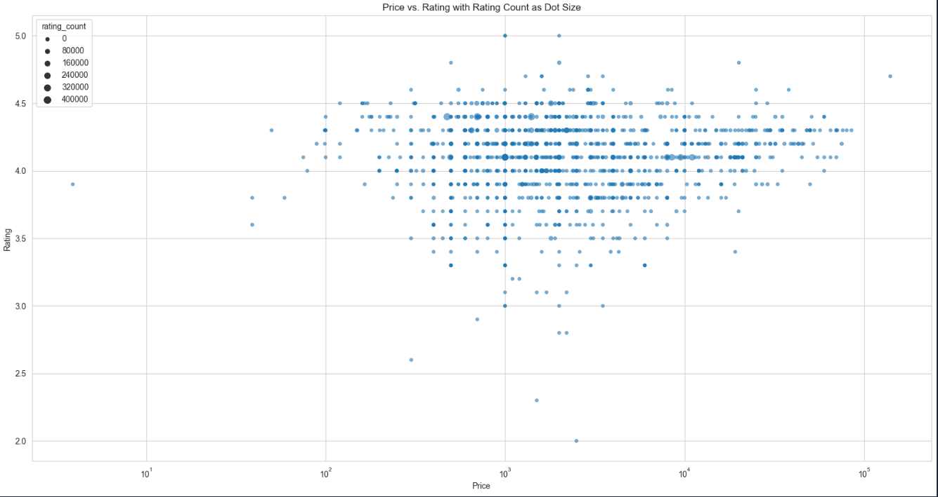
EDA
After exploring the data, products with high ratings typically have higher sales volumes
This tells us that we only want to recommend products with high ratings
Also high prices items tend to receive fewer but more quality-focused ratings
This tells us to have not to high prices for more sales

Slide 7
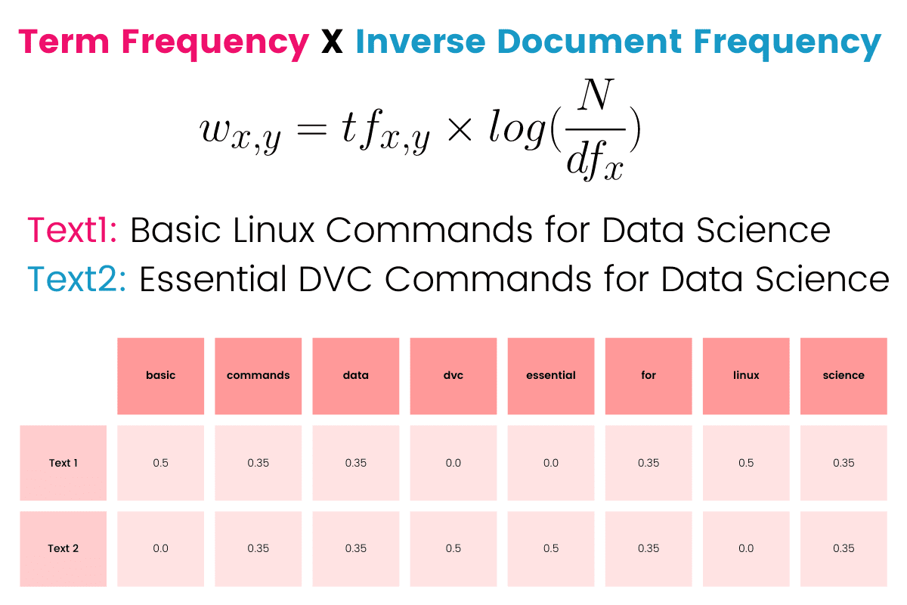
Feature Engineering
Because we are trying to create a profile vector for a product, we combined all text based categories that describe and represent the product and put it into a TF-IDF Vectorizer
Term Frequency (TF): measures how frequently a term occurs in a document.
Inverse Document Frequency (IDF): measures the importance of the term across the corpus.

Slide 8
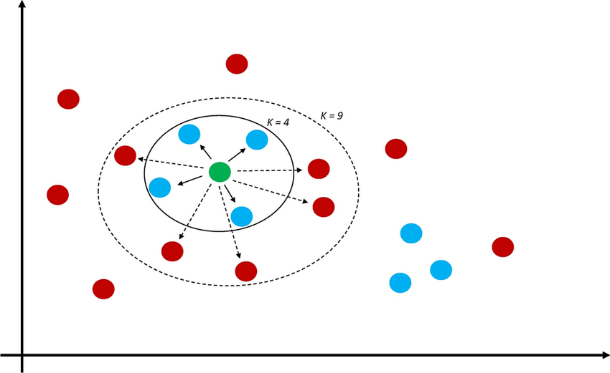
Modeling
After fitting and transforming the data on a TFIDF Vectorizer, we train the matrix on a KNN Model to predict nearest items based on a product

Slide 9
Results
The recommendation system successfully identified 10 relevant items to suggest alongside a primary product, maintaining a balance where half of the recommended products are similar to the primary product, providing familiar options.
The system displayed limitations in depth and creativity by frequently recommending overlapping products, indicating a potential area for improvement in diversifying recommendations.
Despite its flaws, the system effectively supports the primary product with a mix of directly related and varied supporting items, enhancing the shopping experience.

Slide 10
Recommendations
Enhance User Profiles: Increase content-based filtering accuracy by integrating detailed preferences and interaction histories.
Optimize Pricing and Recommendation Diversity: Implement dynamic pricing sensitive to user ratings and periodically introduce novel, diverse items to recommendations to maintain satisfaction and interest.

